Slide 1
Enterprise Systems
Chap# 7,8,9

Slide 2
Post implementation support is generally divided into the five points that follow:
Training. Usually addressed before the Go-live and will continue at varying rates after Go-live, depending on the training strategy to be used.
Go-live support. This is a day-to-day process when the users require assistance in using the system, or related to any mistakes and defects in the new system.
Data validation. This must be conducted periodically to ensure that the system is being used correctly and that data entry processes are being followed.
Data correction. The ability to identify bad data and correct it will be a part of the stabilization process.
Patches and fixes. All during the implementation process and even while in production, software errors/bugs will be encountered and reported to the vendor for a solution.
New features/upgrades. No system is ever complete: Businesses change or grow, and with that the system must keep pace to remain current.

Slide 3
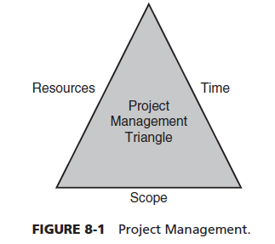
PMO
The project management office (PMO) is responsible for ensuring that project teams are working well together and addressing the functionality issues in a timely, open, and efficient manner. The PMO needs to make certain that team activities stay synchronized and that progress is made. If teams become fragmented, it will often slow down an entire project, especially if teams are dependent on each other for decisions.

Slide 4
Module experts and SMEs is the heart of any project
Module Experts are responsible for analyzing requirements and converting them into solutions within the ERP. Module experts provide direction and application knowledge with respect to business process design, configuration, testing, training, and implementation.
Subject Matter Experts (SMEs) provide coordination and facilitation of communications between the project team and the organization. SMEs coordinate and prioritize functional requirements. SMEs provide leadership and functional expertise in support of the implementation with specific knowledge in one or more business processes.

Slide 5
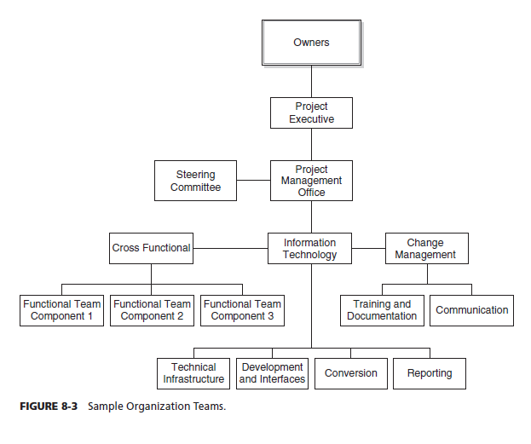
Structure

Slide 6
Issues the PMO will likely need to monitor or address during an ERP implementation:
Project start-up As is often the case, ERP projects can take longer to start than anticipated
2. Interaction or goals between technical and functional staff Any changes to the system configuration or software take time and need to be planned and managed well to ensure that the functional teams can complete their work and move forward.
3. Commitment of senior management for the length of the project This occurs when the system may not work as planned or when there are unanticipated changes and budget overruns.
4. Staff and professional consultant turnover This roll-on process includes orienting the new staff to the teams, implementation methodology, project assumptions, and current project status, as well as their role within the project organization.
5. Second guessing project decisions The one that can be the most damaging is the second guessing from outside the project. This can lead to more implementation issues as the project nears completion and is ready for production.
6. Passive–aggressive staff and users Passive–aggressive staff or users can undermine a project’s motivation and morale. The best approach to ensure that this behavior is minimized is through accountability.

Slide 7
What’s “Organizational Change?”
Typically, the concept of organizational change is in regard to organization wide change, as opposed to smaller changes, such as adding a new person, modifying a program, etc. Examples of organization wide change might include a change in mission, restructuring operations, new technologies, mergers, major collaborations, “rightsizing,” new programs such as Total Quality Management, re-engineering, etc.
What Is Change Management?
Change Management is the process of developing a planned approach to change in an organization. The objective is typically to maximize the collective benefits for all people involved in the change and to minimize the risk of failure of implementing the change. The discipline of change management deals primarily with the human aspect of change, and is therefore related to pure and industrial psychology.

Slide 8
ORGANIZATION PROJECT MANAGEMENT MATURITY MODEL OPM3 model
The OPM3 model is a three-step continuous improvement process. The steps include knowledge, assessment, and improvement.
The benefits of an OPM3 analysis are as follows:
• OPM3 helps organizations identify and deliver the right projects to advance their strategy. With OPM3, you will use organizational inputs to align projects across operations and select only the projects that will deliver business results.
• Improved project performance and return on investment with OPM3—experience a shift in thinking that will position your organization for immediate gains and long-term success. OPM3 isolates process improvements while forcing organizations to consider external pressures increasing operational and organizational efficiency.
• OPM3 helps your organization align its strategy with the projects that sustain business success. Through a comprehensive collection of best practices, OPM3 guides your organization on when to stay the course and when to change direction.
OPM3 mitigates operating costs by keeping projects aligned to business strategy. Scalable by size and maturity, OPM3’s diagnostic capabilities can guide any organization to improved performance.

Slide 9
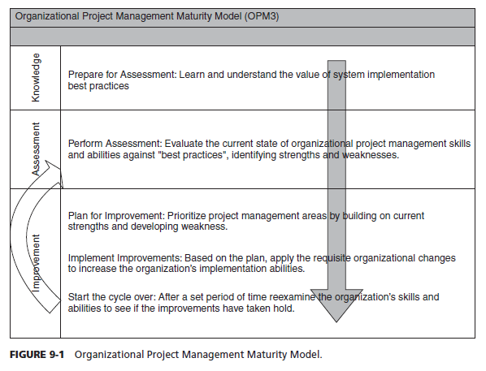
Diagram

Slide 10
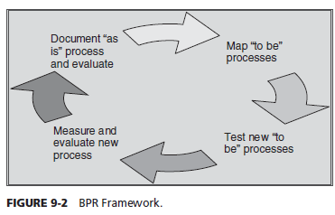
Business Process Reengineering
Business process is defined as “a set of logically related tasks performed to achieve . A process is “a structured, measured set of activities designed to produce a specified output for a particular customer or market. It implies a strong emphasis on how work is done within an organization.
The BPR methodology, includes the following:
1. Preparation—set goals and vision, identify teams, and develop an inventory of processes that need to be evaluated.
2. Define the “as is” process and evaluate cross-organizational issues.
3. Map out “to be” processes based on best practices (i.e., related to ERP).
4. Test and measure new processes based on meeting goals and vision.
5. Reevaluation—revise, adjust to improve processes.

Slide 11
BUSINESS PROCESS MANAGEMENT
According to Gartner, BPM is defined as a management discipline that treats processes as assets that directly contribute to enterprise performance by driving operational excellence and business process agility . BPM employs methods, policies, metrics, management practices and software tools to continuously optimize the organization processes to improve business performance against goals and objectives.
Difference between BPR and BPM
BPR and BPM are not the same, and the differences between them are discussed in this section. BPR suggests that businesses will become competitive by redesigning core business processes. It aims at eliminating the human intervention and automating the process, wherever possible. BPM is not about radical automation; instead, it follows an iterative approach of making incremental improvements in the processes.

Slide 12
Successful implementation of BPM requires separation contains two broad categories of processes from one another.
HUMAN-INTENSIVE PROCESSES These processes are also known as “knowledge work.” They depend on people to do the work. The interaction of people with one another and with the business applications and databases are important. Human intervention is required to make effective decisions. Examples: loan approvals, customer service.
SYSTEM-INTENSIVE PROCESSES These processes involve a large number of automated transactions each day that do not require human judgments and can be easily automated, for example, bank transactions processing.

Slide 13
BPM (Business Process Management)
Major features of BPM software to manage business processes
Process modeling and simulation—Users can directly use the software to design the processes that need to be automated, graphically. BPM software has drag-and-drop features to develop processes.
• Systems integration—BPM software lets other information systems like ERP to be connected to the processes, and hence information can flow between the systems.
• User interaction and collaboration—BPMS has Web forms and other user interfaces to help the user to enter inputs and make other changes to the process.
• Process execution and monitoring—BPMS lets job to be routed through the process steps and sends notifications electronically and also tracks performance indicators of processes.
The benefits of BPM are driven by the “Four Rs of Process”:33
• Roles—establishing a set of defined user roles that will not change with employee absences or departures
• Relationships—identifying the interactions necessary to complete a process
• Rules—developing a fixed set of process steps that will be followed in most situations
• Routing—electronically transferring forms and documents for review, approval, and so on.

